Slide 1


Slide 2

CONTENT
GENERAL GUIDELINES
STUDENTS
PBL
RESEARCH AND RANKING
BUSINESS COLLABORATION
STRATEGY 2016-21

Slide 3

Introduction, change random picture

Slide 4

AAU – KNOWLEDGE FOR THE WORLD
All degree programmes and research activities at Aalborg University are problem and project-based and have an interdisciplinary focus.
Through strong interplay between staff and students and intense collaboration with public and private sectors, we offer degree programmes with a real-world approach and provide world-class research.
This results in new insights, new solutions to societal challenges and knowledge that changes the world.

Slide 5
AAU – KNOWLEDGE FOR THE WORLD
All degree programmes and research activities at Aalborg University are problem and project-based and have an interdisciplinary focus.
Through strong interplay between staff and students and intense collaboration with public and private sectors, we offer degree programmes with a real-world approach and provide world-class research.
This results in new insights, new solutions to societal challenges and knowledge that changes the world.

Slide 6
Time Management Table
Name | Time holding breath under water | Time without criticizing work | Time used for eating
Nicolai | 29:10 | 29:10 | 20:00
Thassilo | 10:02 | 10:02 | 20:00
Aitor | 00:17 | 00:17 | 20:00
Nicolas | 19:57 | 00:00 | ∞

Slide 7
Problem statement and objectives
How can a module integrated converter be designed to maximize
the PV power generation under real conditions?
Objectives:
Design a DC-DC converter for integration with a PV panel.
Implementation of an MPPT algorithm.
Hardware implementation of the MIC.
Test of the system and validation of the MIC.

Slide 8
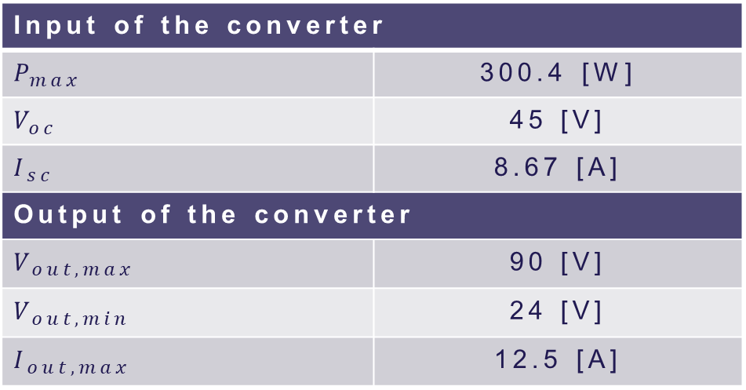
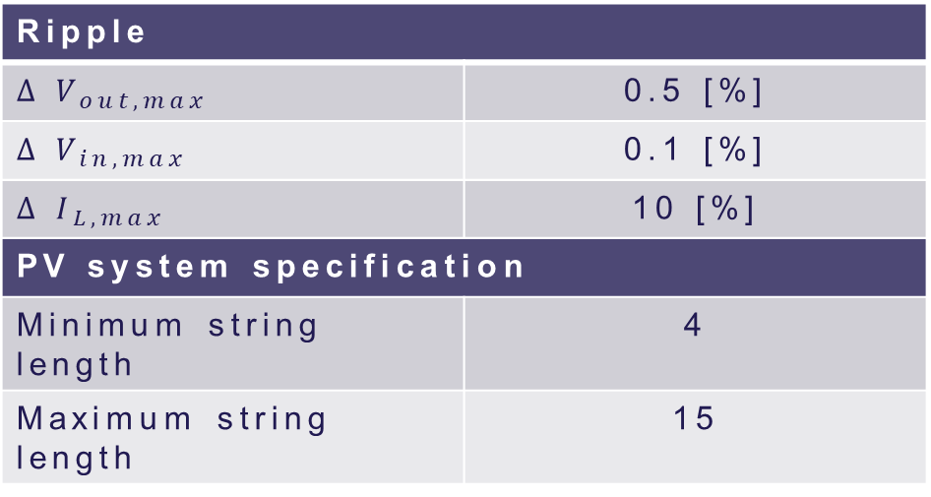
System requirements
Input of the converter
$$P_{max}$$ | 300.4 [W]
$$V_{oc}$$ | 45 [V]
$$I_{sc}$$ | 8.67 [A]
Output of the converter
$$V_{out,max}$$ | 90 [V]
$$V_{out,min}$$ | 24 [V]
$$I_{out,max}$$ | 12.5 [A]
Ripple
$$∆ V_{out,max}$$ | 0.5 [%]
$$∆ V_{in,max}$$ | 0.1 [%]
$$∆ I_{L,max}$$ | 10 [%]
PV system specification
Minimum string length | 4
Maximum string length | 15

Slide 9
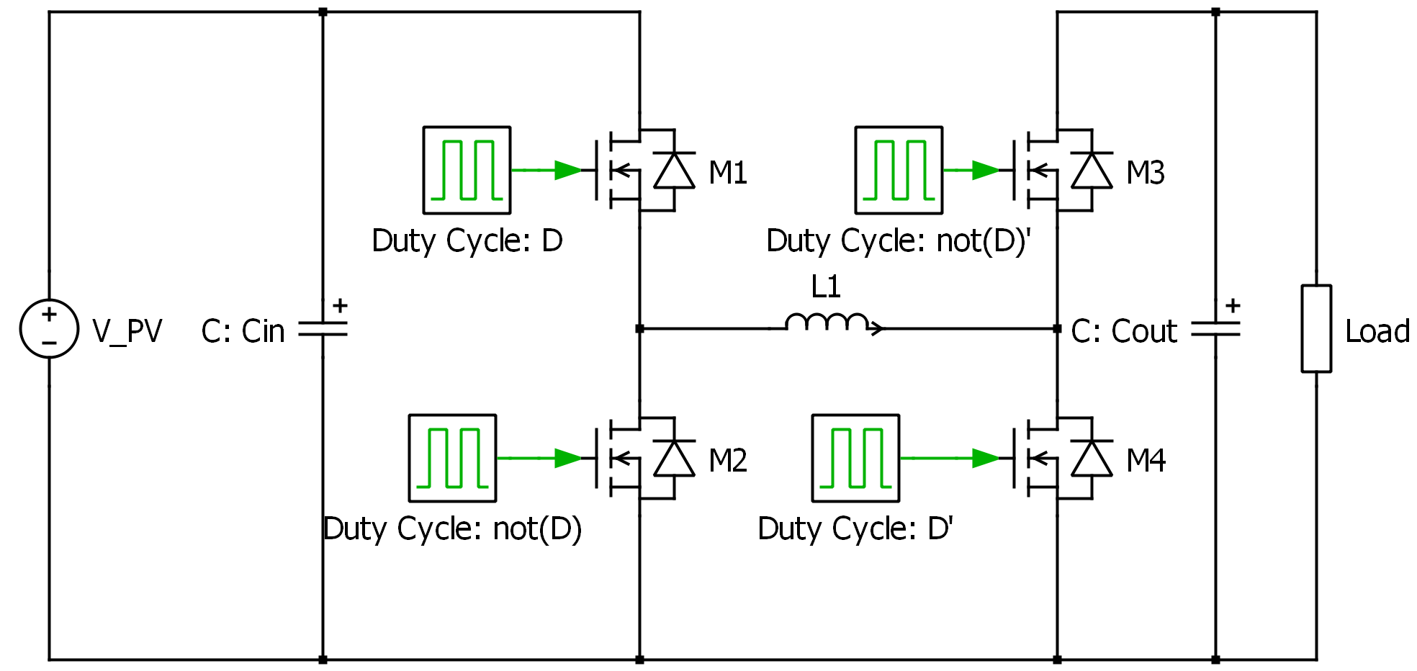
Selection of topology
Non-inverting buck-boost converter

Slide 10
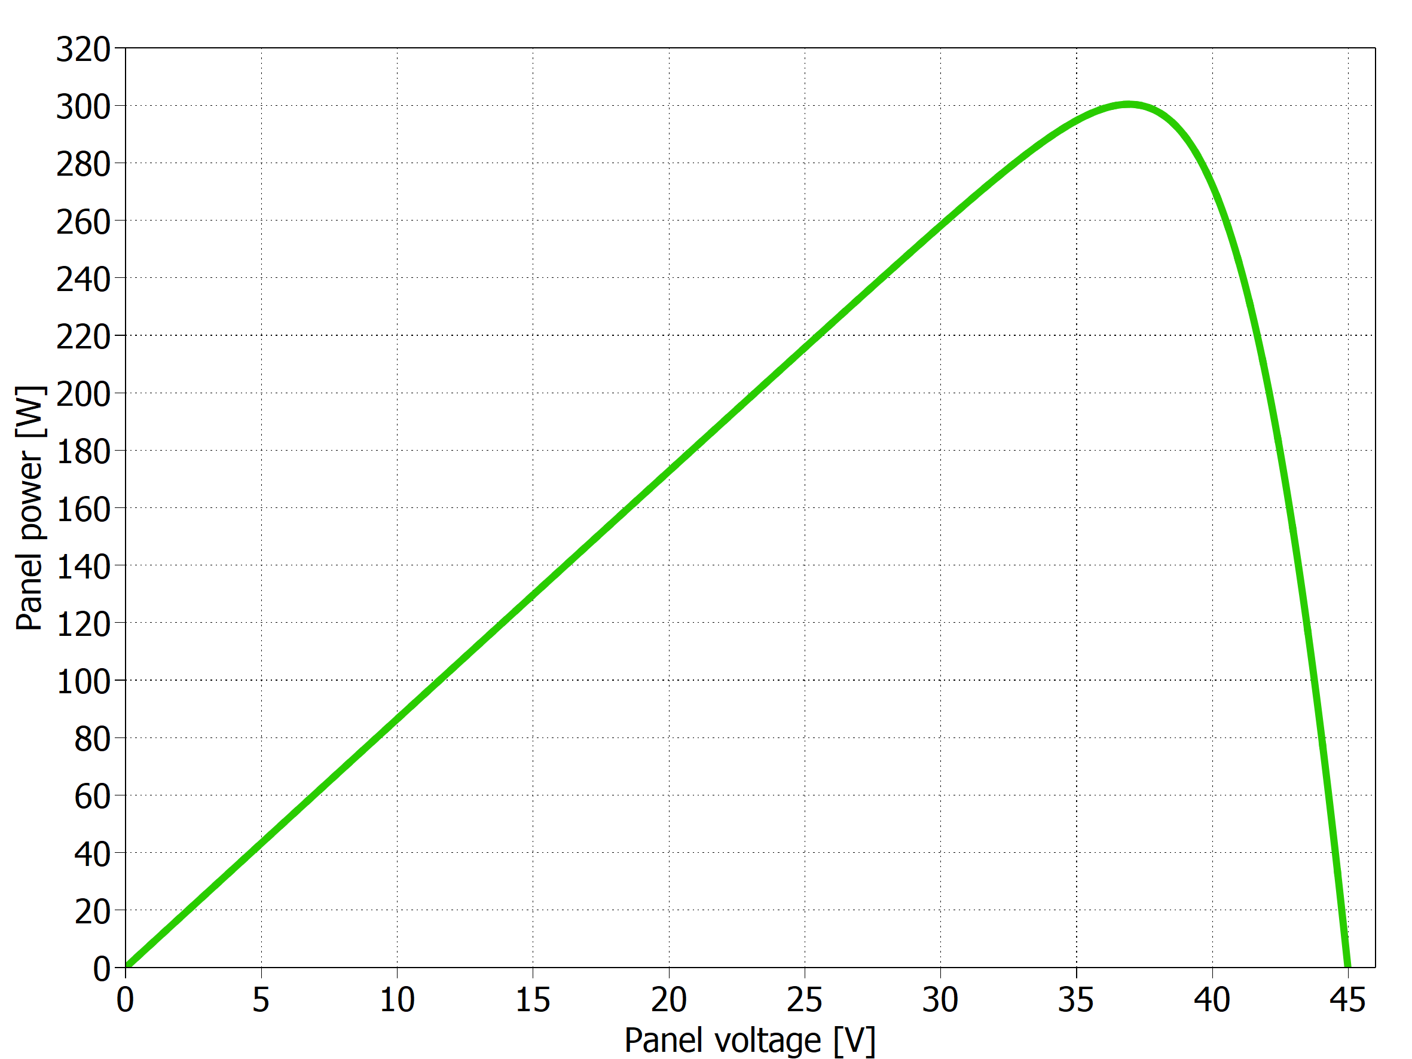
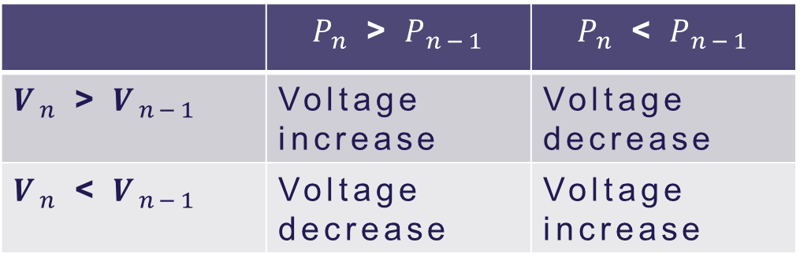
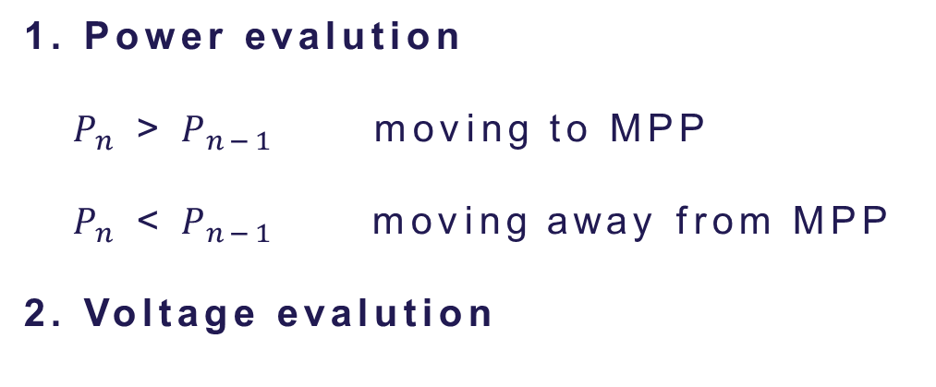
Perturb & Observe technique
1. Power evalution
$P_{n}$ > $P_{n−1}$ moving to MPP
$P_{n}$ < $P_{n−1}$ moving away from MPP
2. Voltage evalution
 | $P_{n}$ > $P_{n−1}$ | $P_{n}$ < $P_{n−1}$
$V_{n}$ > $V_{n−1}$ | Voltage increase | Voltage decrease
$V_{n}$ < $V_{n−1}$ | Voltage decrease | Voltage increase
P-V curve from a PV panel

Slide 11
Perturb & Observe technique
Pro: required computing power is low (simplest implementation)
Contra: algorithm oscillates around MPP with fix step
(simplest implementation)

Slide 12
Implementation
Block diagram of the system including the MPPT

Slide 13
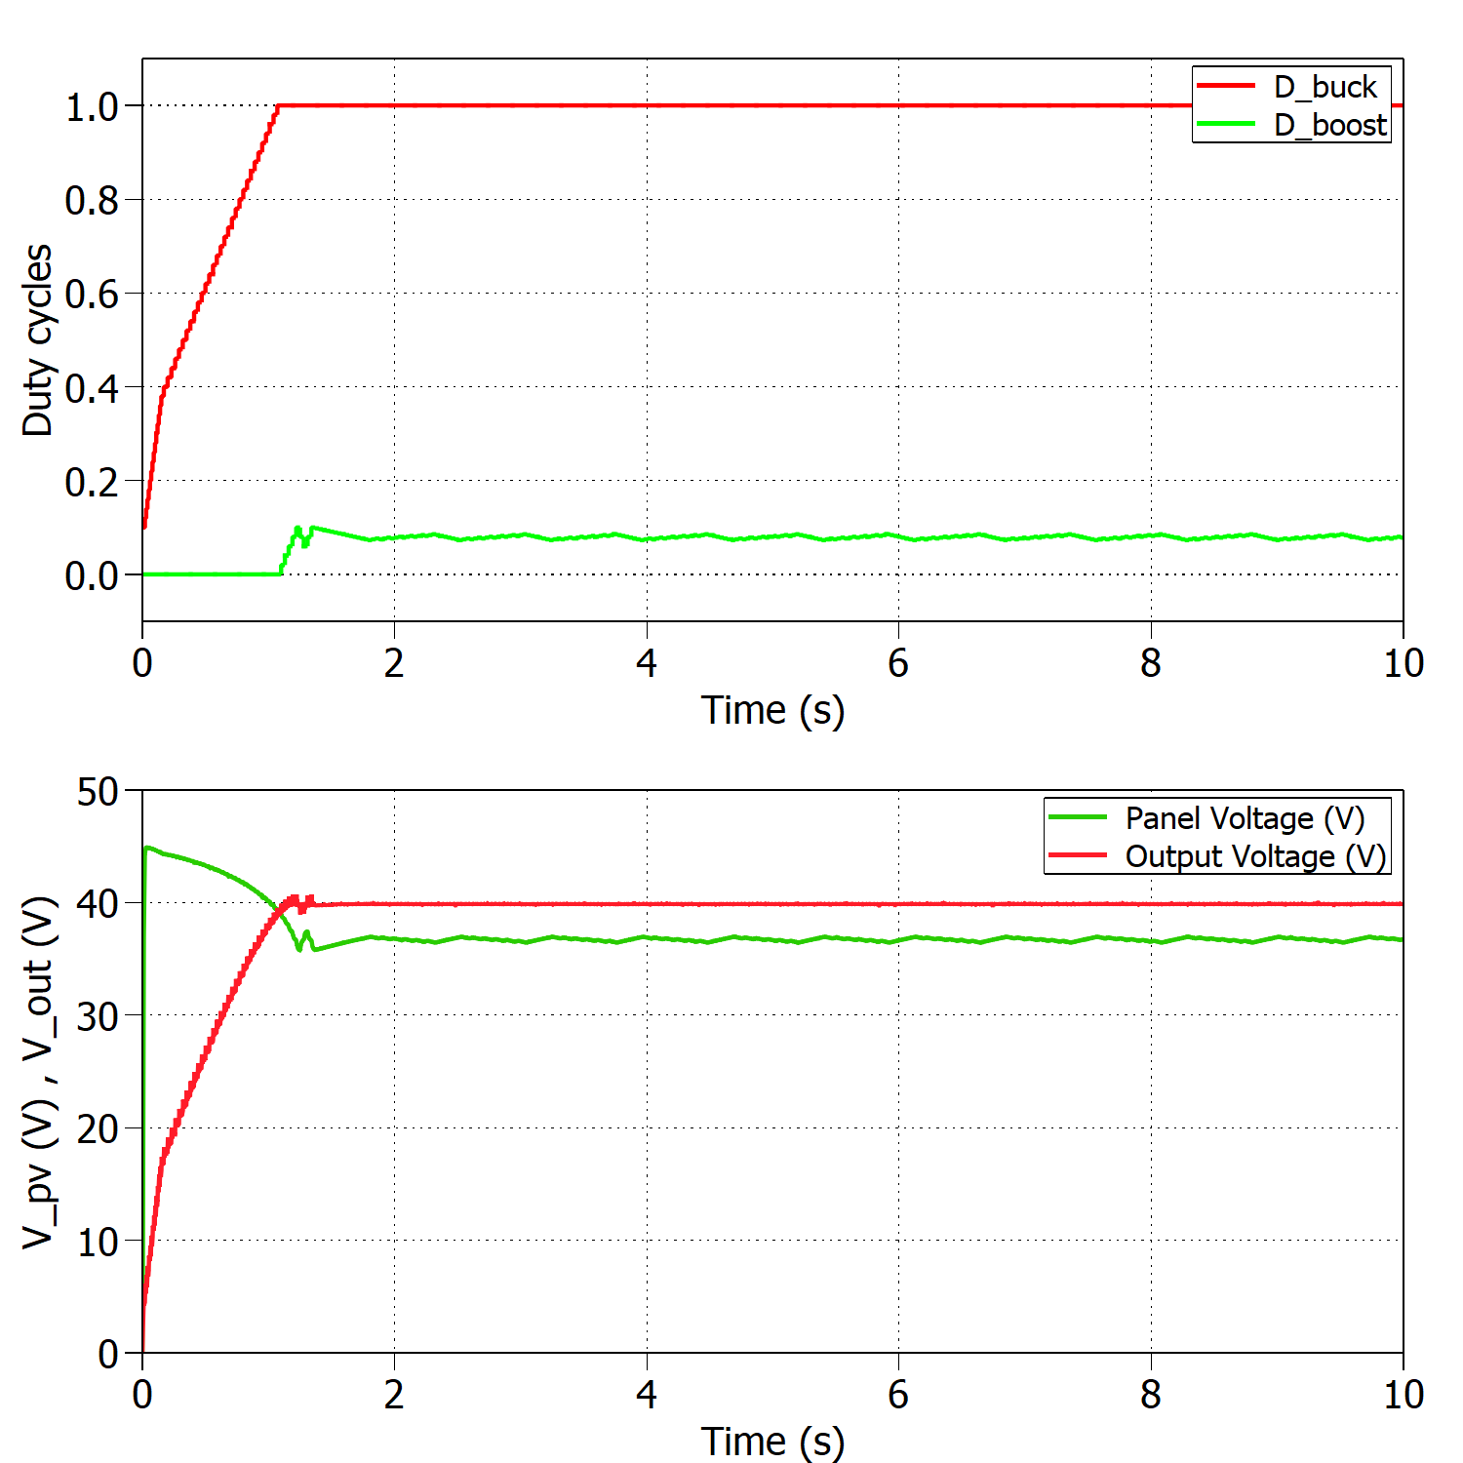
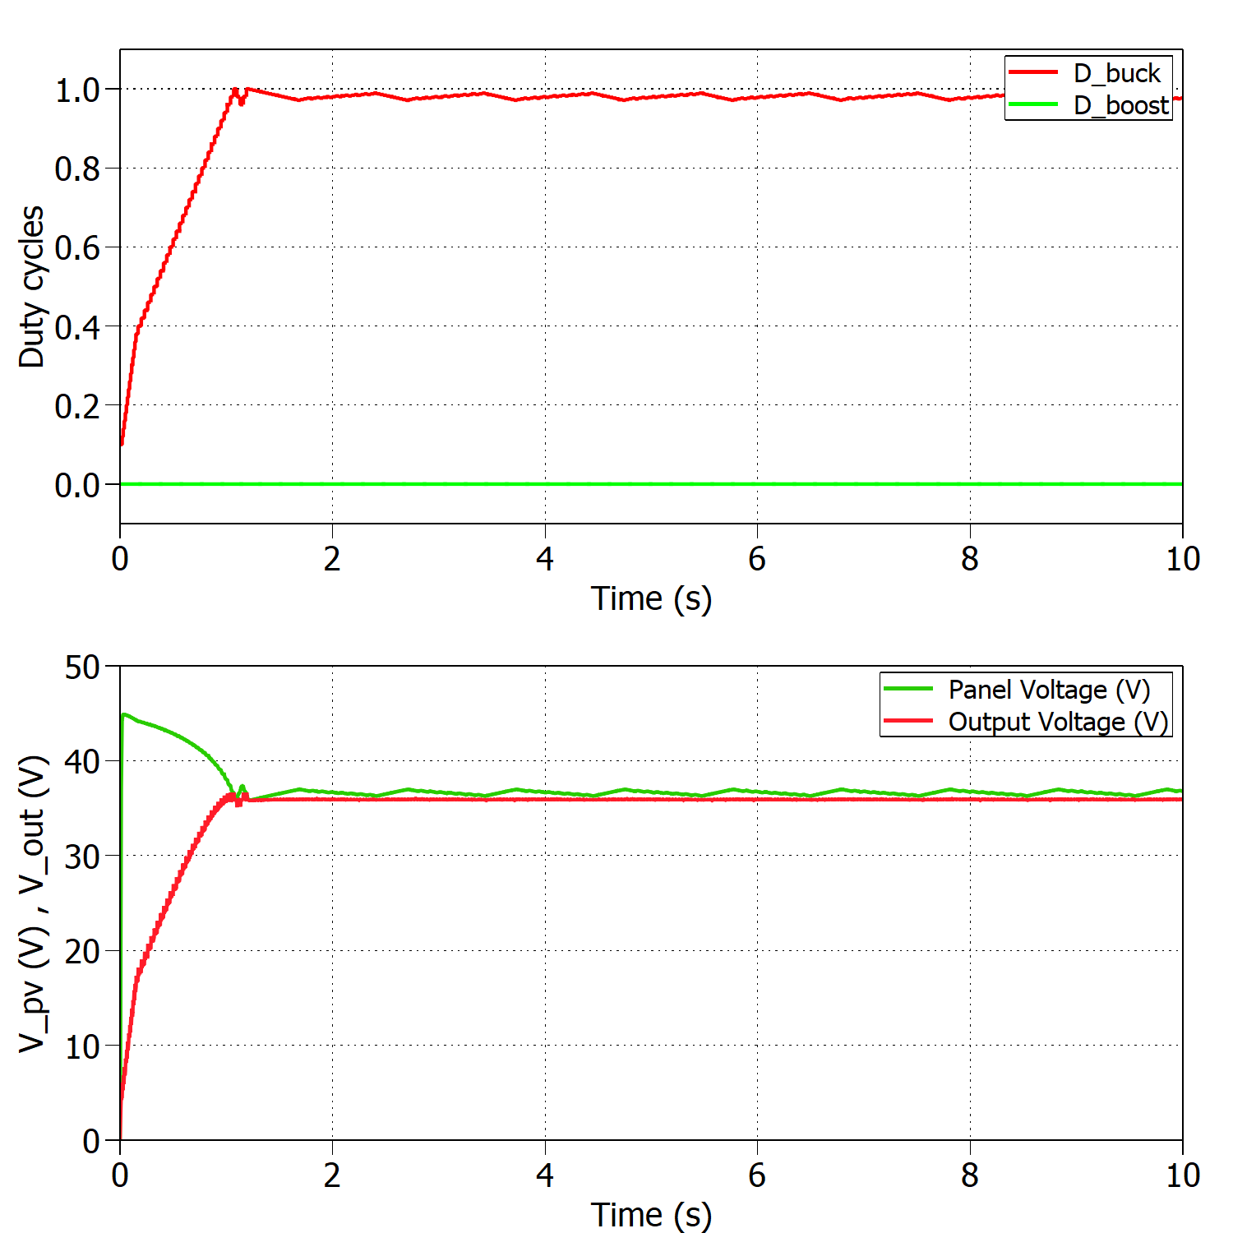
Time Management Table
Add a nice looking caption if you have multiple figures at one slide
And make sure that they are better aligned than this…

Slide 14
Converter design, change random picture

Slide 15
Converter design, change random picture

Slide 16
Converter design, change random picture

Slide 17
Converter design, change random picture

Slide 18

Thank you for your attention
Questions?

